Slide 1
Thinking, Language, and Intelligence
Psych 101-C
February 18 and 20, 2025

Slide 2
Overview: Today’s class
Upcoming assignments, including book club project
Intelligence, thinking, and language
Intelligence activity

Slide 3
Office Hours
Alyssa Z (McCreary 313D): Tue., 7:00 – 9:00
Wed., 7:00 – 8:00
Prof. Cain (323 McCreary ): Tue., 2:30 – 4:00
Thur., 2:30 – 4:00
and by appointment

Slide 4
Upcoming work
Quiz 5 (Ch. 7) due by 11:55 pm, Sun., Feb. 23
Read Ch. 8; complete videos and mini-quizzes by Tue., Feb. 25
Show me your book by Thur., Feb. 27
Article summary paper due Tue., Mar. 4

Slide 5
Book groups
Will, Malek, Luke F, Stefano – Man’s Search for Meaning
Tonoy, Abir, Tejaswi, Sapujya – Educated
Charlotte, Grace – Brain on Fire
Anthony, Luke I, Zoe – Into the Woods
Blake, Jacob, Jayden – My Grandmother’s Hands
Alikhan, Danny, Giorgi, Marwo – 10% Happier
Aaditya, Aayam – Maybe You Should Talk to Someone

Slide 6
Thinking, Language, and Intelligence
Cognitive Psychology
Thinking
Language
Intelligence

Slide 7
Cognitive Psychology
Focuses on thinking, reasoning, language, memory, etc. – all of which are mental processes
Uses scientific methods to study mental processes.
Led to “cognitive revolution” in the 1950s and 60s.

Slide 8
Thinking (section 7.1; pp. 226 – 240)
Mental representation
Concepts
Problem-solving

Slide 9
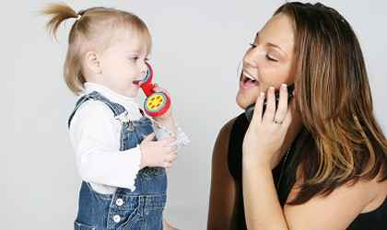
Language
Characteristics of language
Theories of language acquisition
Major language milestones in development
Critical periods and the case of Genie

Slide 10
Characteristics of Language
Communication includes
Gestures
Facial expressions
Language
Language is a significant and (probably) uniquely human means of communication.
Language involves combining arbitrary symbols in systematic ways that convey meaning.

Slide 11
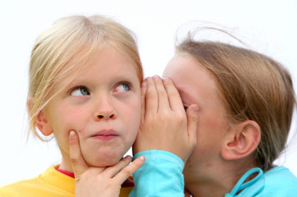
Characteristics of Language
It’s meaningful (semantics).
Displacement
It’s rule-governed (grammar/syntax).
It’s social (pragmatics).
It’s creative/generative.
Notes:
Symbolism, Displacement
Combinatorial system – phonemes, morphemes, sentences

Slide 12

Theories of Language Acquisition
Behaviorist – Skinner, 1957
Language is learned from the environment through operant conditioning and observation

Slide 13
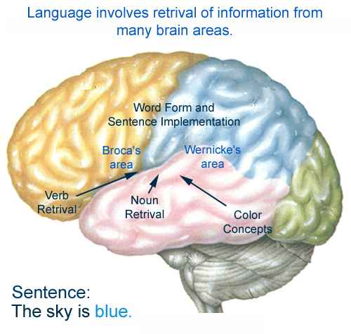
Theories of Language Acquisition
Behaviorist – Skinner, 1957
Nativist/Biological – Chomsky, 1957
Language is learned
through innate biological
structures and
mechanisms.

Slide 14
Theories of Language Acquisition
Behaviorist – Skinner, 1957
Nativist – Chomsky, 1957
Interactionist – Tomasello, 1995, Bloom & Tinker, 2001
Language is learned through
biological mechanisms, but also
requires and is shaped by
the environment.

Slide 15
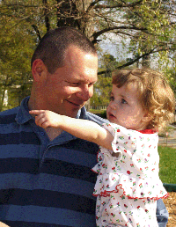
Language Milestones
Preverbal communication – birth to 12 months
First words – 12 months
Word combinations – 18 mos. – 3 years
Vocabulary spurt – 18 mos. – 2 years
Complex language
By age 3, children can use complete sentences and hold conversations.
By age 5, children have mastered most of the grammar of their language.
Continue to grow in vocabulary
Continue to learn a few aspects of grammar (e.g., passive voice in English)

Slide 16
The Case of Genie
Critical period hypothesis (Lenneberg, 1967)
Genie’s background
Genie’s language development
Genie and theories of language acquisition

Slide 17
Summary: Language

Slide 18
Intelligence and Intelligence Testing
What is intelligence?
Definition
Models of intelligence
Nature and nurture
Evidence for each side
Group differences in performance/Discrimination and IQ
Intelligence testing
History of intelligence testing
IQ definition
IQ test construction
Some intelligence tests
Purpose and limits of intelligence testing

Slide 19
Your child’s teacher tells you that your child is very bright and is likely to do well at everything she tries. Which theorist does your child’s teacher seem to agree with?
Spearman
Sternberg
Gardner
None of the above

Slide 20
Discuss in a small group
What have you learned about intelligence during your years of growing up? How did you learn it?

Slide 21
Nature and Nurture (Biology and Environment)
Clear evidence that both influence intelligence (as measured by IQ).

Slide 22
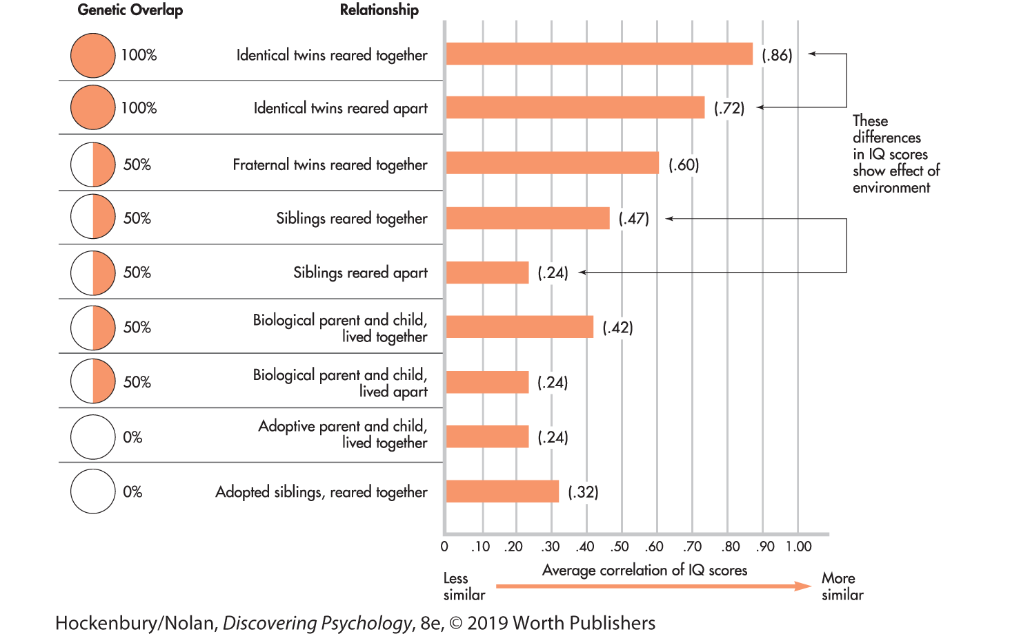
Twin Studies and Family Studies: Evidence for Genetic and Environmental Contributions to Intelligence/IQ (see p. 253 in textbook).

Slide 23
Heritability Estimate
Within a given population, about 50% of the variation in IQ scores is due to genetic factors.
This number is still debated strongly.
It applies to differences among individuals in the same group, but it doesn’t mean that IQ within one individual is caused 50-50 by genes and environment.
It doesn’t explain anything about differences between populations/groups with different backgrounds and circumstances.

Slide 24
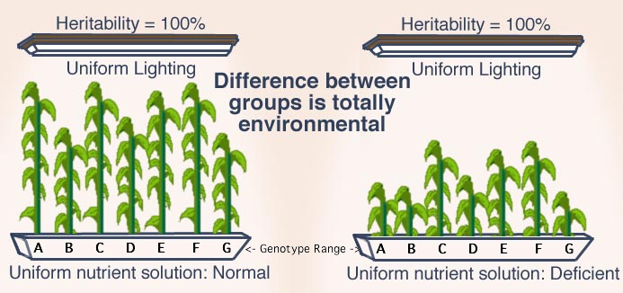
Heritability

Slide 25
Evidence for Environmental Contributions to Intelligence: IQ Scores change over the course of development
Average change is 13 points – almost 1 SD – from age 5 to 17
Price, 2011 (Nature)
Gave IQ tests to 33 healthy neuro-typical teens aged 12 to 16
Tested again four years later
IQ scores showed dramatic changes – decreased by up to 18 points or increased by up to 21 points
20% of children changed so much that they moved into new IQ categories
If IQ scores change, they can’t be a fixed thing determined solely by genetics.

Slide 26
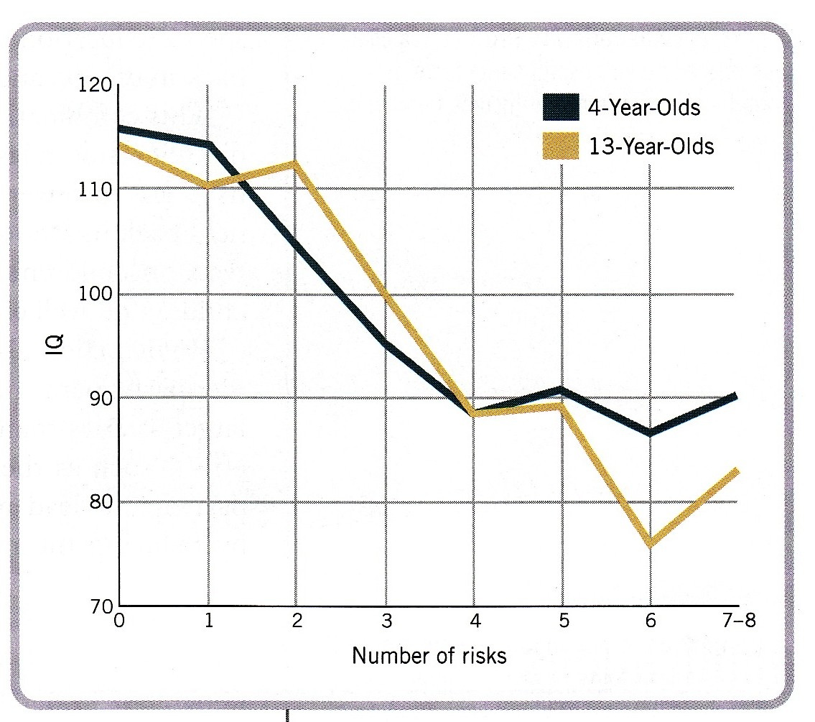
Evidence for Environmental Contributions to Intelligence/IQ: Risk Factors and Intelligence (Sameroff, 1993)
Notes:
Sameroff, 1993
Examples of risk factors – head of household unemployed or in low-status occupation, mother very low education, no father in home, large number of stressful events, poor maternal mental health

Slide 27
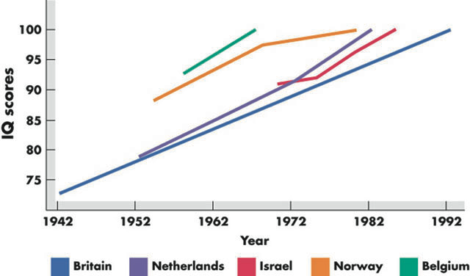
Evidence for Environmental Contributions to Intelligence/IQ: The Flynn Effect (Flynn, 1999)

Slide 28
Evidence for Environmental Contributions to Intelligence/IQ: Exposure to pesticides among children in Mexico (Guillette et al., 1998)

Slide 29
Evidence for Environmental Contributions to Intelligence/IQ: Discrimination and IQ (DeVos & Wagatsuma, 1967)
In many countries, people from marginalized groups score lower on IQ tests than people from the dominant group.
Burakumin – marginalized social class in Japan
Not racially distinct from majority Japanese

Slide 30
Evidence for Environmental Contributions to Intelligence/IQ: Discrimination and IQ (DeVos & Wagatsuma, 1967)
In many countries, people from marginalized groups score lower on IQ tests than people from the dominant group.
Burakumin – marginalized social class in Japan
Not racially distinct from majority Japanese
In Japan, their average IQ is lower than that of majority Japanese

Slide 31
Discrimination and IQ (DeVos & Wagatsuma, 1967)
 | % of children | % of children
Range of IQ Scores | Non-Burakumin | Burakumin
Above 125 | 23.3 | 2.6
109 – 124 | 31.8 | 19.5
93 – 108 | 23.3 | 22.1
77 – 92 | 11.7 | 18.2
76 or lower | 9.9 | 37.6

Slide 32
Evidence for Environmental Contributions to Intelligence/IQ: Discrimination and IQ (DeVos & Wagatsuma, 1967; Ogbu, 1986)
In many countries, people from marginalized groups score lower on IQ tests than people from the dominant group.
Burakumin – marginalized social class in Japan
Not racially distinct from majority Japanese
In Japan, their IQ is lower than that of majority Japanese
BUT – when Burakumin immigrate to the US, their IQ scores and school performance are equal to those of other Japanese-Americans (Ogbu, 1986)

Slide 33
Heritability

Slide 34
Which source of evidence most strongly supports the view that intelligence is shaped by the environment?
Studies of the effect of risk factors on IQ
The Flynn Effect
Twin and family studies
A and B

Slide 35
Which source of evidence most strongly supports the view that intelligence is shaped by the environment?
Studies of the effect of risk factors on IQ
The Flynn Effect
Twin and family studies
A and B

Slide 36
Intelligence and Intelligence Testing
What is intelligence?
Definition
Models of intelligence
Nature and nurture
Evidence for each side
Group differences in performance/Discrimination and IQ
Intelligence testing
History of intelligence testing
IQ definition
IQ test construction
Some intelligence tests
Purpose and limits of intelligence testing

Slide 37
Intelligence tests – early history
The first successful tests were designed by Binet and Simon in 1904 at the request of the French minister of education.

Slide 38
Intelligence tests – early history
Binet and Simon’s goal was to identify children who would have genuine difficulty learning in school.
They focused on higher-level skills such as reasoning and problem-solving because these are necessary for school success.

Slide 39
Intelligence tests – early history
Binet and Simon’s goal was to identify children who would have genuine difficulty learning in school.
They focused on higher-level skills such as reasoning and problem-solving because these are necessary for school success.
They picked typical school-related questions for different age groups and sorted children by whether they answered as expected for their age.

Slide 40
Intelligence tests – early history
Binet and Simon’s goal was to identify children who would have genuine difficulty learning in school.
They focused on higher-level skills such as reasoning and problem-solving because these are necessary for school success.
They picked typical school-related questions for different age groups and sorted children by whether they answered as expected for their age.
They recommended “mental exercises” to improve intelligence for children who received low scores.

Slide 41
Intelligence and Intelligence Testing
What is intelligence?
Definition
Models of intelligence
Nature and nurture
Evidence for each side
Group differences in performance/Discrimination and IQ
Intelligence testing
History of intelligence testing
IQ definition
Principles of test construction
Some intelligence tests
Purpose and limits of intelligence testing

Slide 42
IQ Definition
Binet and Simon originally scored children’s “mental age.”
Stern (1912) designed a formula that shifted the emphasis to whether children were where they should be for their age, rather than focusing on mental age alone.
IQ = MA/CA x 100

Slide 43
Stern’s formula for IQ
IQ = MA/CA x 100
Where MA = Mental Age
CA = Chronological Age
e.g., if a 10-year-old child performs like a 7-year-old,
IQ = 7/10 x 100 = 70.
If she performs like a 12-year-old,
IQ = 12/10 x 100 = 120.
An IQ of 100 is exactly average for one’s age.

Slide 44
Deviation IQ
Over the years, problems with the “mental age” concept became apparent.
Now IQ is scored based on deviation from the norm for the age, without invoking the concept of “mental age.”
Average IQ is 100.
IQ’s are scored by how many standard deviations above or below the age mean children’s responses are.

Slide 45
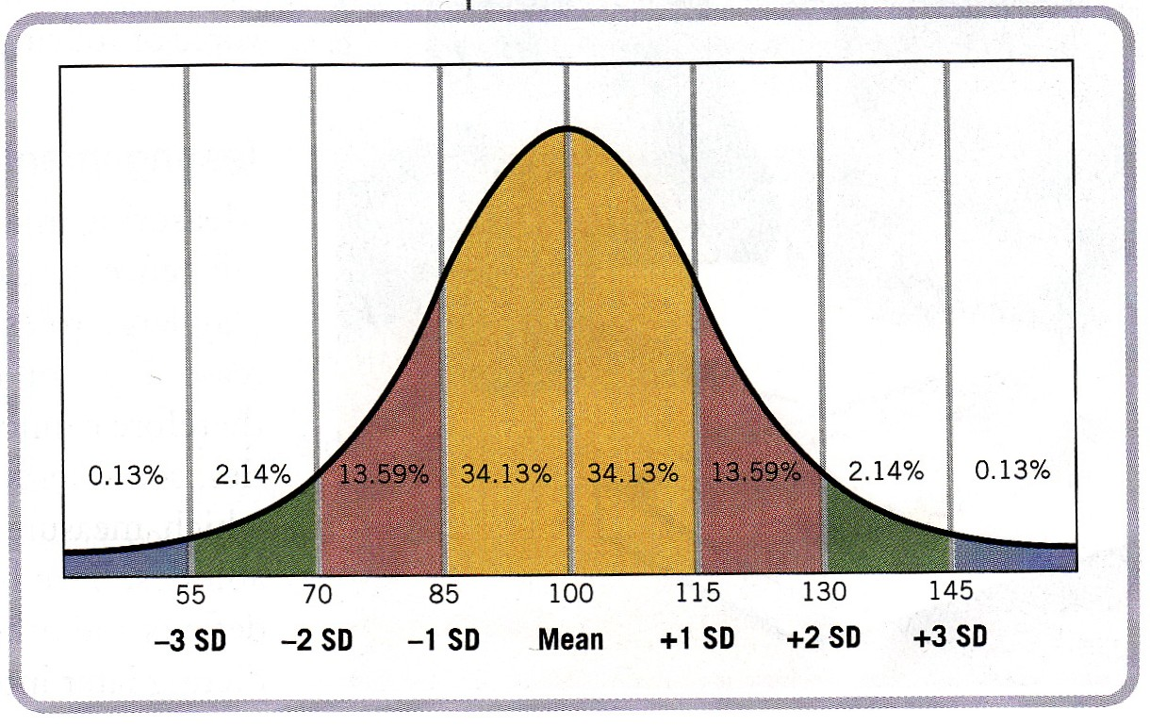
Deviation IQ
Notes:
Any published IQ test is “standardized” on a very large sample of children from many backgrounds.
Average scores are published for each age group.
The child receives a raw score for his or her performance.
The raw score is compared to the raw score for others of the same age.
The child’s IQ score is a measure of how many standard deviations his or her raw score is above or below the average for that age group.
E.g., a 4-year-old with a raw score of 56 on a given test may be 1 SD above average for his age and get an IQ score of 115; a 6-year-old with a raw score of 56 may be 1 SD below average for his age and get an IQ score of 85.

Slide 46
Consider the case of 10-year-old Ellen, whose IQ score is 150. Understood as deviation IQ, this score means that:
Ellen should be treated exactly as a teenager, given her advanced mental age.
Ellen’s IQ score is a little higher than typical scores for other children her age.
Ellen’s IQ score is substantially higher than typical scores for other children her age.
Ellen’s score is below typical scores for her age and suggests she’ll require special support in school.

Slide 47
Consider the case of 10-year-old Ellen, whose IQ score is 150. Understood as deviation IQ, this score means that:
Ellen should be treated exactly as a teenager, given her advanced mental age.
Ellen’s IQ score is a little higher than typical scores for other children her age.
Ellen’s IQ score is substantially higher than typical scores for other children her age.
Ellen’s score is below typical scores for her age and suggests she’ll require special support in school.

Slide 48
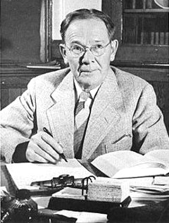
Intelligence tests – early history
Lewis Terman (1916) – adapted Binet’s test for US: Stanford-Binet
Focused on intelligence as more fixed – less emphasis on changeable school skills.

Slide 49
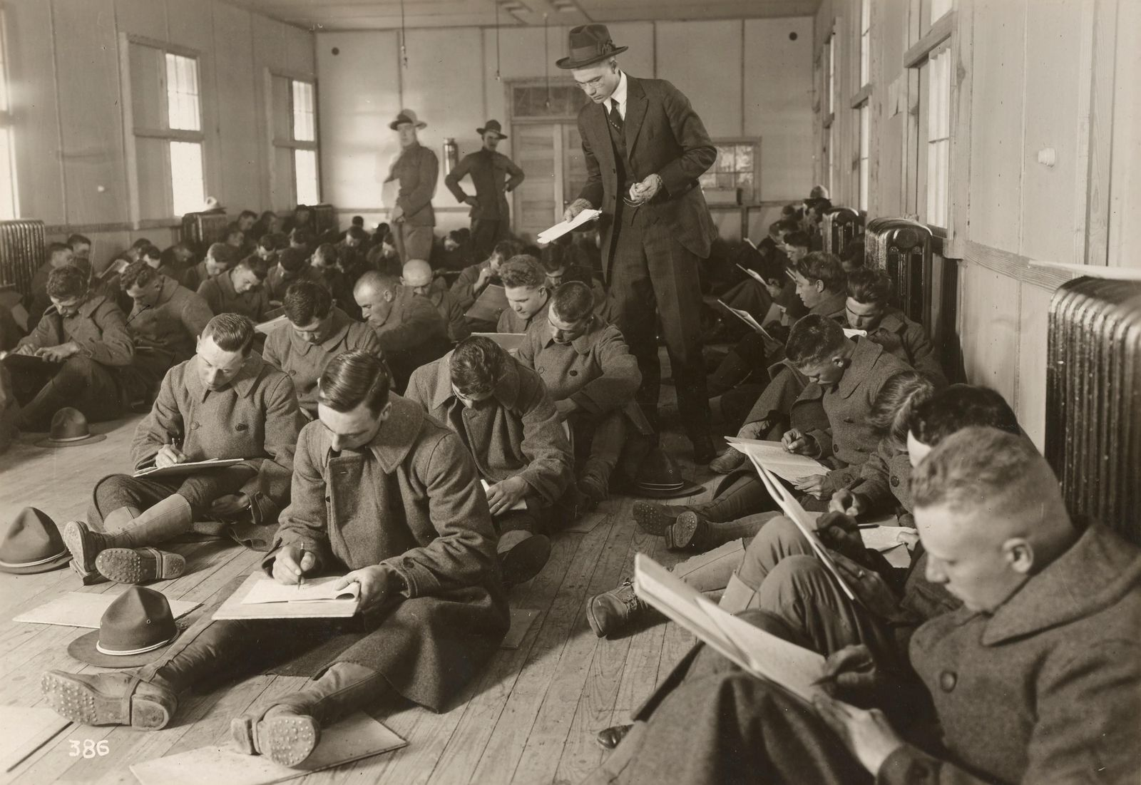
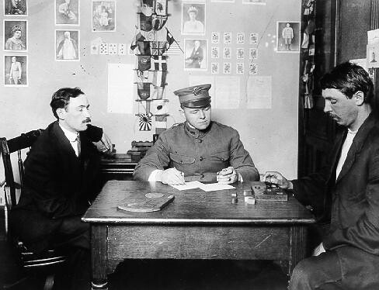
Intelligence tests – early history
Lewis Terman (1916) – adapted Binet’s test for US: Stanford-Binet
Became the basis for testing
Army recruits
Immigrants

Slide 50
Principles of Test Construction
Standardization – a good test is given to a large representative sample before being published and is given approximately the same way every time. Standardization allows one person’s scores to be compared to typical scores.
Reliability – test results are consistent for the same person over a short period of time (e.g., test-retest or split-half reliability)
Validity – the test measures what it’s supposed to measure (e.g., IQ should correlate with school performance)

Slide 51
Stanford-Binet, 5th Edition (2003)

Slide 52
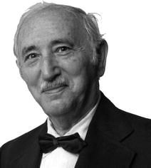
Wechsler Intelligence Scales
Includes a variety of verbal and performance (non-verbal) subscales
WAIS (Wechsler Adult Intelligence Scale)
WISC (Wechsler Intelligence Scale for Children)
WPPSI (Wechsler Preschool and Primary Scale of Intelligence)

Slide 53
Terminology
Verbal IQ
Performance IQ
Spatial reasoning
Fluid intelligence
Crystallized intelligence
WISC-V (2015)

Slide 54
WISC (original version)
Verbal section
Information (What is the capital of Russia? What is steam made of? What is pepper?)
Vocabulary (What is a treaty? What does “articulate” mean?)
Similarities (How are a mountain and a river alike? How are a bird and an airplane alike?)
Arithmetic (If 4 friends divided 48 cookies equally, how many did each one get? If a train travels 60 mph, how long will it take the train to travel 180 miles?)
Comprehension (Why do we have jails? What is the advantage of keeping money in a bank?)
Digit span (Repeat these numbers in order: 5, 3, 7, 4, 9.)

Slide 55
WISC (original version)
Performance section
Picture completion (a clock without a 7, a car without wheels)
Picture arrangement (arrange cartoon frames to tell a story)
Block design
Object assembly (puzzle pieces form a common object, such as a horse or car)
Coding (children write simple numerical codes such as “plus” signs under various geometric shapes)
Mazes

Slide 56
WISC Picture Completion

Slide 57
WISC Picture Arrangement

Slide 58
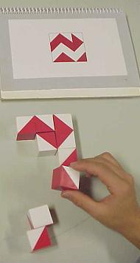
WISC Block Design

Slide 59
WISC Object Assembly

Slide 60
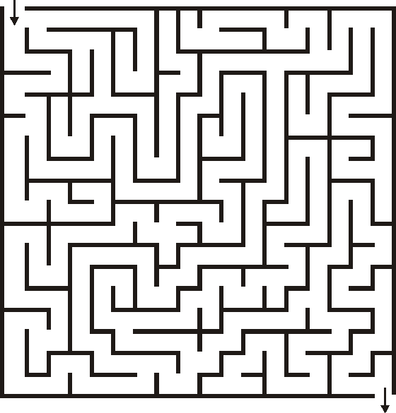
WISC Mazes

Slide 61
As a school psychologist, you discover that 6-year-old Lev, who comes from an impoverished background and doesn’t speak English at home, has a verbal IQ of 90 and a performance IQ of 130. What should you do, based on your knowledge of IQ tests?
Recommend Lev for a classroom of slow learners.
Evaluate Lev’s English language skills.
Evaluate Lev for a possible learning disability.
B and C
All of the above.

Slide 62
As a school psychologist, you discover that 6-year-old Lev, who comes from an impoverished background and doesn’t speak English at home, has a verbal IQ of 90 and a performance IQ of 130. What should you do, based on your knowledge of IQ tests?
Recommend Lev for a classroom of slow learners.
Evaluate Lev’s English language skills.
Evaluate Lev for a possible learning disability.
B and C
All of the above.

Slide 63
Purpose and Limits of Intelligence Testing
IQ tests are useful for predicting whether children will have difficulty in school.
IQ tests are useful for diagnosing learning difficulties and designing treatment plans.
They are good, but far from perfect, predictors of economic and occupational success.

Slide 64
Purpose and Limits of Intelligence Testing
Intelligence and IQ are constructs, not actual “things” inside us.
IQ tests don’t measure a fixed genetic ability.
IQ scores reflect people’s environment and experiences as well as their aptitude.
IQ scores can and do change.
IQ scores don’t measure a person’s value to society.
IQ scores are not a valid way to infer genetic reasons for group differences.

Slide 65
Summary: Intelligence and Intelligence Testing
What is intelligence?
Definition
Models of intelligence
Nature and nurture
Evidence for each side
Group differences in performance/Discrimination and IQ
Intelligence testing
History of intelligence testing
IQ definition
Some intelligence tests
Purpose and limits of intelligence testing

